Slide 1
Executive Function
Computational Cognitive Neuroscience
Jessica Mollick, Randy O’Reilly

Slide 2
Definition of executive function
A process used to effortfully guide behavior towards a goal, especially in non-routine situations
Multi-faceted, may include:
Inhibiting familiar/stereotyped behavior
Maintain an idea of which information is relevant right now
Resist distracting information
Switch between goals
Definition from Banich, 09
Notes:
Banich, 2009

Slide 3
Very relevant example
How do I get into grad school?
Figuring out what I am interested in
Working in a lab to learn about research
Contacting professors to get recommendations
Looking at schools
Sending applications & taking tests on time
Going to interviews (Social skills, learning skills)
Making a decision about where to go
Listing pros and cons
Notes:
Or for me, where do I want to get a post-doc?
All of these decisions involve advance planning, focusing on your goals, ignoring irrelevant information and switching between multiple different goals

Slide 4
Why do we care?
Clinical disorders involve impairments in executive function
Depression:
Enhanced focus on negative stimuli
Addiction
Enhanced focus on & behavior to seek out addictive substance
Poor top-down control/inhibition of drug-seeking response
OCD
Habit pathway – prepotent responses to distressing stimuli must be overcome with cognitive control
Put your favorite disorder here – chances are it involves EF deficits (see Snyder, 2016)

Slide 5
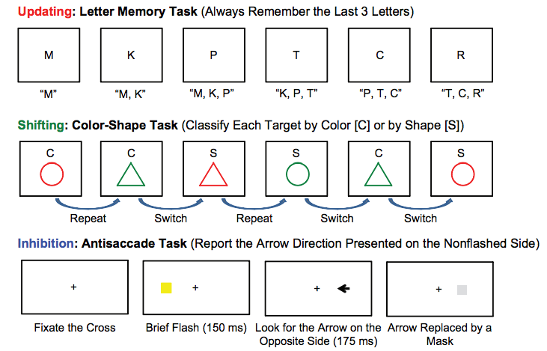
Examples of different EF tasks
Notes:
Updating – you are putting the letters in working memory & updating as different letters come along
Shifting: You are switching between the relevant rule (color or shape)
Inhibition: You want to look for the arrow on the opposite side that is being cued- this involves inhibiting your “automatic” response to look places when cued

Slide 6
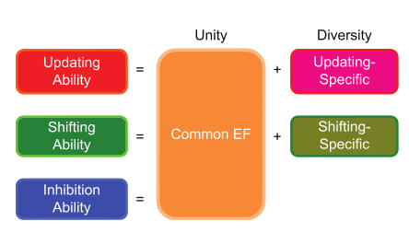
Different parts of EF
Friedman & Miyake, 2012
Notes:
In this “factor” analysis, they compared performance of several updating and shifting tasks to find out what abilities were shared among them
They found a “common” EF ability that correlated with the ability to do all of these tasks, as well as specific updating and shifting abilities that were specific to those types of tasks
Inhibition was not a specific factor, but correlated with common EF

Slide 7
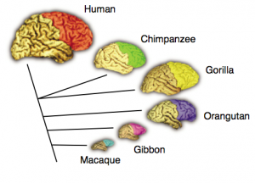
Prefrontal cortex across species
Notes:
The prefrontal cortex (also called neocortex), is most developed in humans. In the graphic below, you can see that monkeys, especially chimpanzees and gorillas also have a prefrontal cortex

Slide 8
Prefrontal cortex across life
Does this development of prefrontal cortex link to impairments in decision making you may see with adolescents?

Slide 9
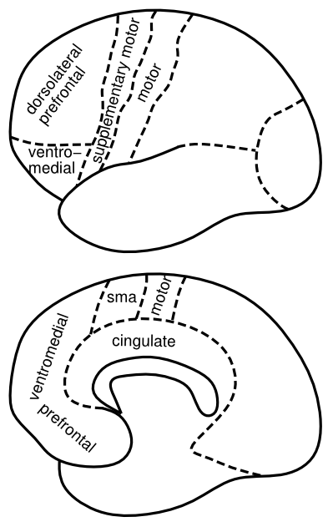
Who is in Charge of your Brain??
Prefrontal Cortex?
Integrates:
Cognitive Control
Planning
Motivation
Reward processing
Decision making
Notes:
Who is actually in charge of your brain? Key area is the prefrontal cortex
Includes more “cold” task based areas (DLPFC), emotional & decision making areas (VMPFC & OFC)
Motor areas (Motor cortex)

Slide 10
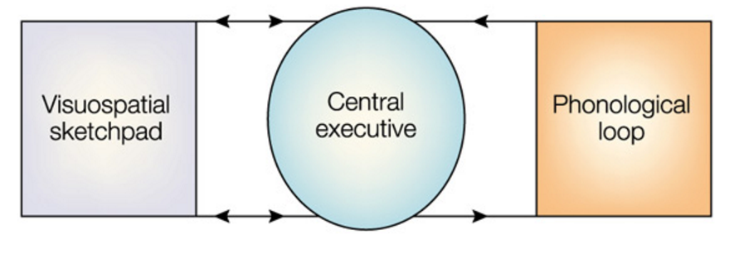
Baddeley/Hitch model
Influential account of working memory
Phonological loop: Hold information for a few seconds, maintain through rehearsal
Central executive: Switch & focus attention
Visuospatial sketchpad: ongoing manipulation of visual/spatial items
Notes:
http://link.springer.com/article/10.1007/s11065-007-9040-z

Slide 11

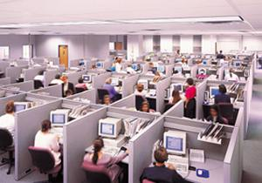
Key Idea: Top-Down Biasing
PFC active maintenance provides top-down biasing of posterior-cortical processing
Notes:
“Central executive”- The idea of a boss or CEO that controls the actions of all of the lower level brain areas
Top-down biasing – information from the executive gets sent down to lower level workers in the company
The PFC does this by maintaining task goals or rules, which bias processing in lower/posterior areas

Slide 12
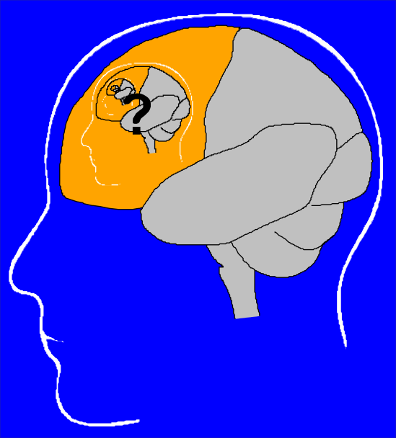
The Homunculus Problem
Notes:
How is the “central executive” difference than a homunculus? If there is a little man in your brain making all your decisions?
The central executive in Baddeley is sometimes understood as proposing a homunculus, but the Baddeley model does not rule out mapping things anatomically

Slide 13
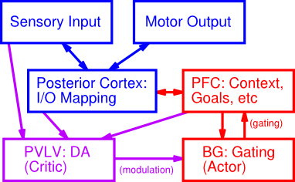
It Takes a Network..
Notes:
How to we avoid this homunuclus problem?
Relating this to what we learned earlier in the class – the brain is actually a network, which involves many different areas
Key Connection is the PFC to posterior cortex regions

Slide 14
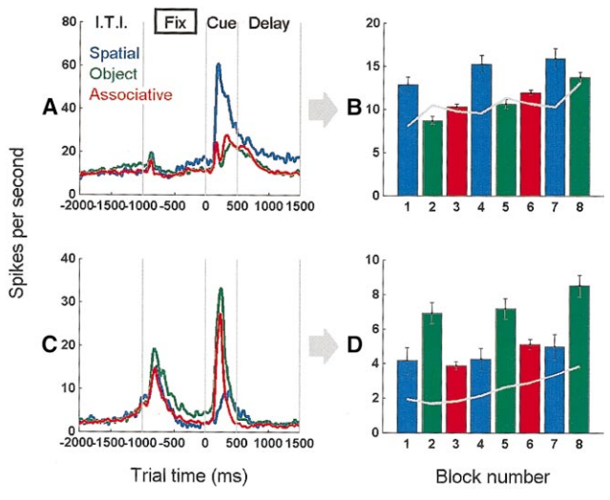
What is the PFC maintaining?
Miller – 2000 - Monkey does several different tasks
During the delay period, you see differences in activity depending on the task, meaning that the PFC encodes “task” rules

Slide 15
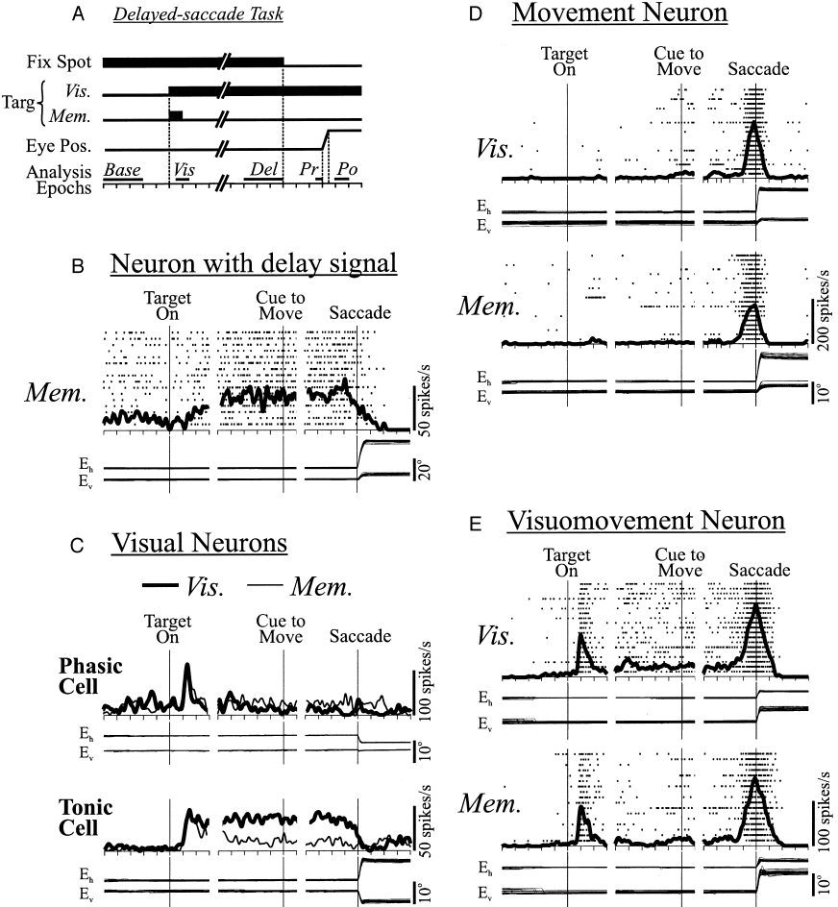
PFC Does Active Maintenance
Notes:
Key finding – while visual and movement neurons show transient activity to either the cue or he movement (or both),
The delay signal neurons are in the prefrontal cortex, which continue their activity from the onset of the cue until the monkey makes a saccade
”Active” maintenance- the monkey is maintaining the goal of completing a saccade, which is maintained online

Slide 16
Active Maintenance Can Do it All
Cognitive Control
Maintained activity drives top-down biasing
Planning
Think about things that are not there (future)
Motivation
Maintain goals
Reward processing
Maintain possible outcomes
Decision making
Maintain alternatives
Notes:
Going back to everything the PFC does

Slide 17
The Need for Robust Maintenance
"Every sound has to be an earthquake or tidal wave that topples governments and changes national boundaries and mutates whole species so they suddenly drift off the planet, across galaxies, only to return, years later, when nobody wants to know them cause their credit rating's bad or because they can't do the Mashed Potatoes.” - MFU by HC, 1998
Subjective experience of PFC lesion: dreaming!
Notes:
Above is a quote from somebody with a PFC lesion. Shows you that without the PFC, you get a stream of conciousness narrative
Remind you perhaps of a dream?
PFC is deactivated during sleep

Slide 18
Stroop Task: Top Down Biasing
RED

Slide 19
Stroop Task: Top Down Biasing
GREEN

Slide 20
Stroop Task: Top Down Biasing
RED

Slide 21
Stroop Task: Top Down Biasing
GREEN

Slide 22
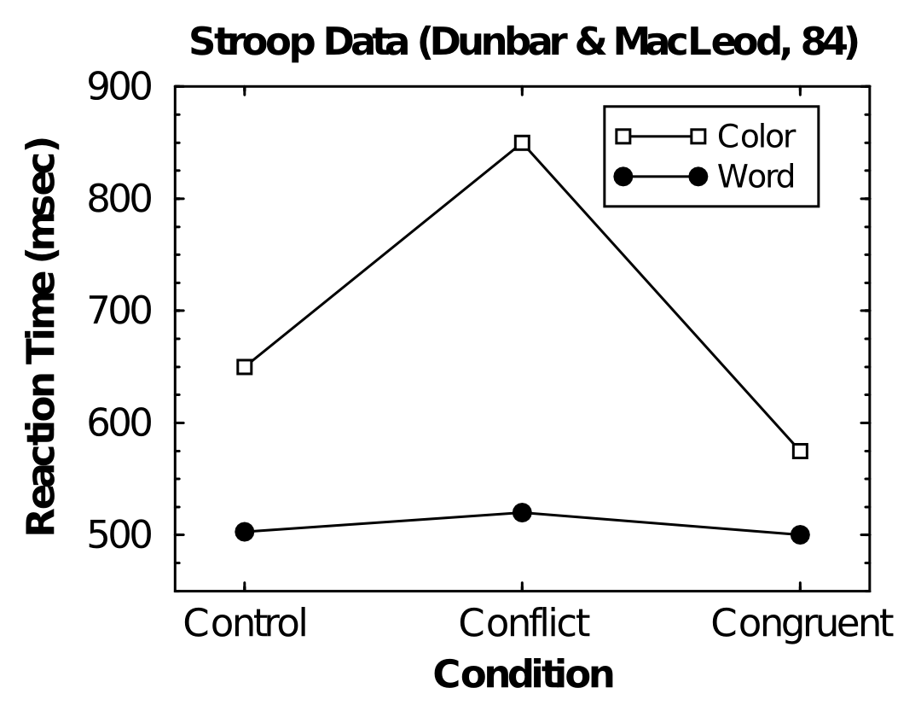
Asymmetric Conflict
Notes:
Shows an interesting effect – there is big reaction time cost for color in the conflict conditions, but not as much in the word condition
Why? Prepotent responses to read words- when you see a word, want to read it

Slide 23
Model of the Stroop task
Notes:
Gilbert & Shallice 2002- Modification of Cohen model- very similar to stroop model used in class
Stronger connection from word-reading units to output than color output units – simulates greater experience reading words
“Task demand units” – top down control to prevent the units for the irrelevant task from being active
Similar to Stroop model in the class & gives some idea of how to model conflict

Slide 24
Robust Active Maintenance
In Stroop model, we just clamp PFC units on..
What makes them “clamped” in the real brain?
How do the PFC units show sustained activity?
BG!

Slide 25
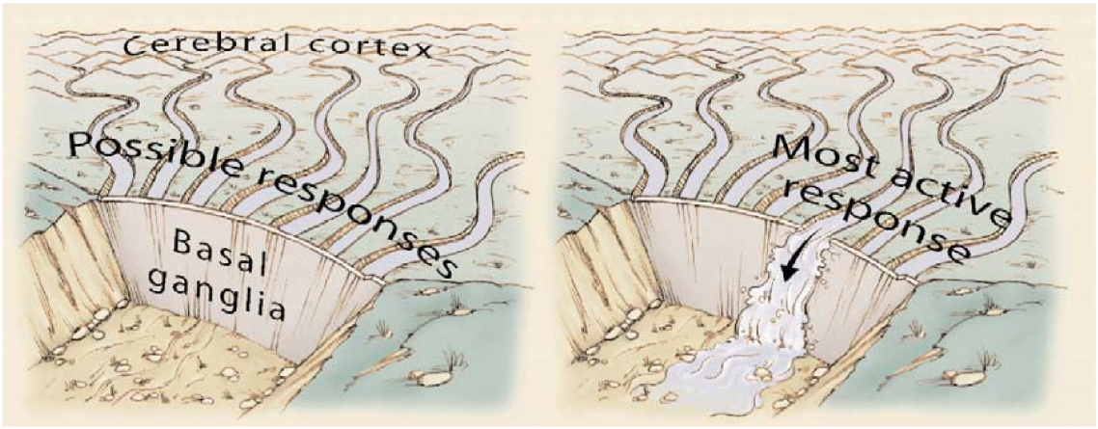
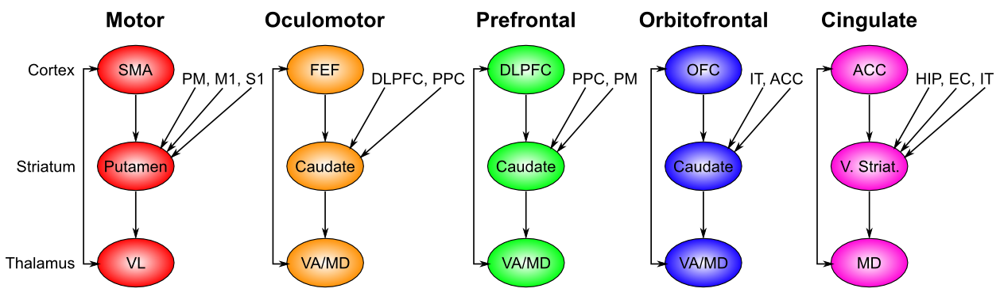
Motor Gating => Cognitive Gating
Notes:
The basal ganglia acts as a “gate” – when open- lets the most active response through & allows execution
Does this by communication with the thalamus, which talks to cortex and “gates” in maintained representations into the PFC
Basal ganglia is key structure for gating not only motor actions, but also task goals (DLPFC), reward expectations (OFC) and action plans (ACC)

Slide 26
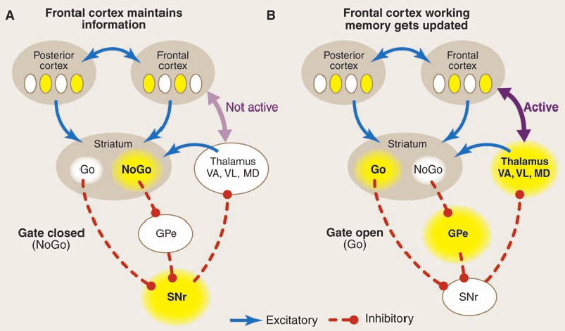
Dynamic, Adaptive Gating (BG)
Toggles PFC bistable states
Resembles transistor logic gate!
Notes:
How does it do this? The PFC has two important active states-
Maintaining, where the gate is the basal ganglia is closed, and the PFC maintains whatever information is there currently, in the face of oncoming distractions
Indirect pathway prevents updating
Updating – may remind you of “updating” tasks – the Basal ganglia gate is open, and the connection between thalamus and PFC allows an update of the PFC representation
Direct pathway neurons fire & disinhibit the frontal cortex, producing a gating event to update WM
Parallel loops of PFC/BG connectivity allow selective updating

Slide 27
PBWM System (O’Reilly, Frank 06)
Notes:
Sensory inputs mapped to motor via a “posterior” hidden layer – like parietal (sensory/motor combo)
PFC maintains relevant prior information & goals, influences the mapping of sensory to motor
BG drives updating in PFC via dynamic gating
PVLV controls the dopamine signal, which lets it learn when to update
BG = Actor (Picking out potential action plans) & PVLV providing the dopamine depending on whether actions are good or bad

Slide 28
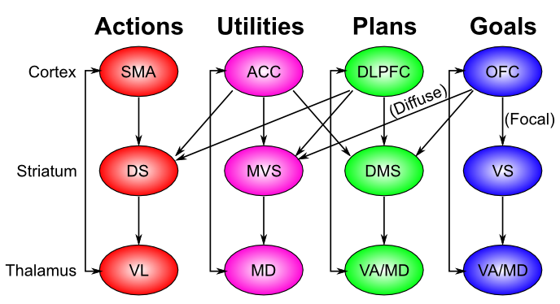
Chain of Command..
Notes:
You have a whole swatch of PFC that maintains different aspects of what you need for executive functions

Slide 29
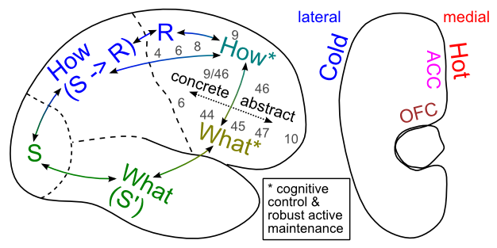
Executive Function
Notes:
Other important dimension of PFC function is the what/how distinction, which maps onto the dorsal/ventral distinction you see in other brain regions – based on connectivity with dorsal & ventral visual pathways (Dorsal-motion & motor responses; ventral- object identity)
How= dorsal-lateral PFC
Parietal – Stimulus response rules
Rostral-caudal axis: Gradient of abstaction – more concrete to abstract
Ventral regions – vlPFC & OFC show a “what” encoding- specific objects or reward associations

Slide 30
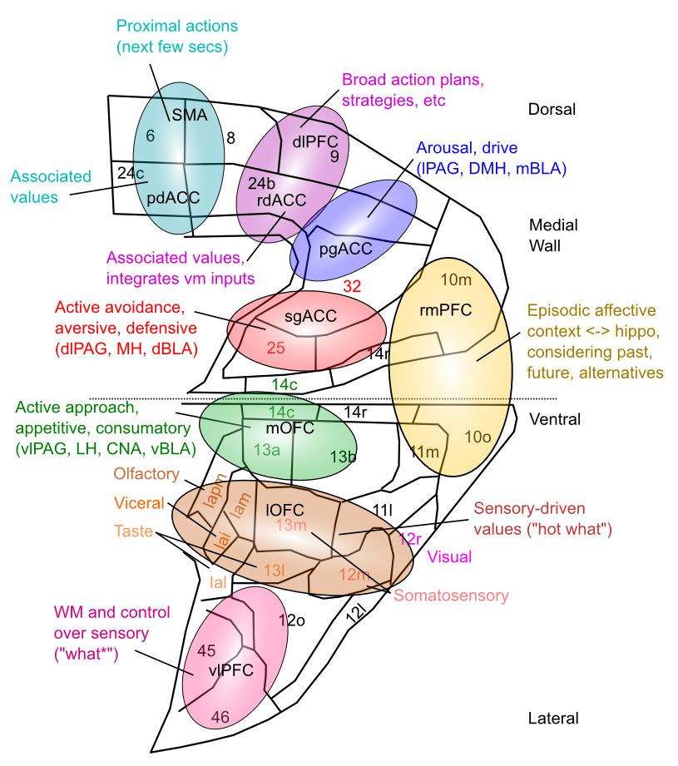
Medial Frontal Map of Values This is your emotional life

Slide 31
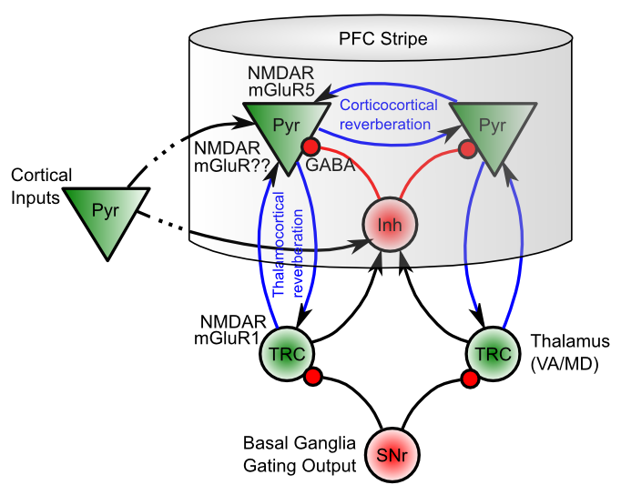
Biological Basis of PBWM
Notes:
mGLu-R receptors particularly good for active maintenance.
Key idea of PFC “stripes” = part of cortex connected to specific parts of BG to maintain things

